Slide 1
Using Diagnostic Tests to Evaluate Student Understanding
Presented by
Glenn Wagner

Slide 2
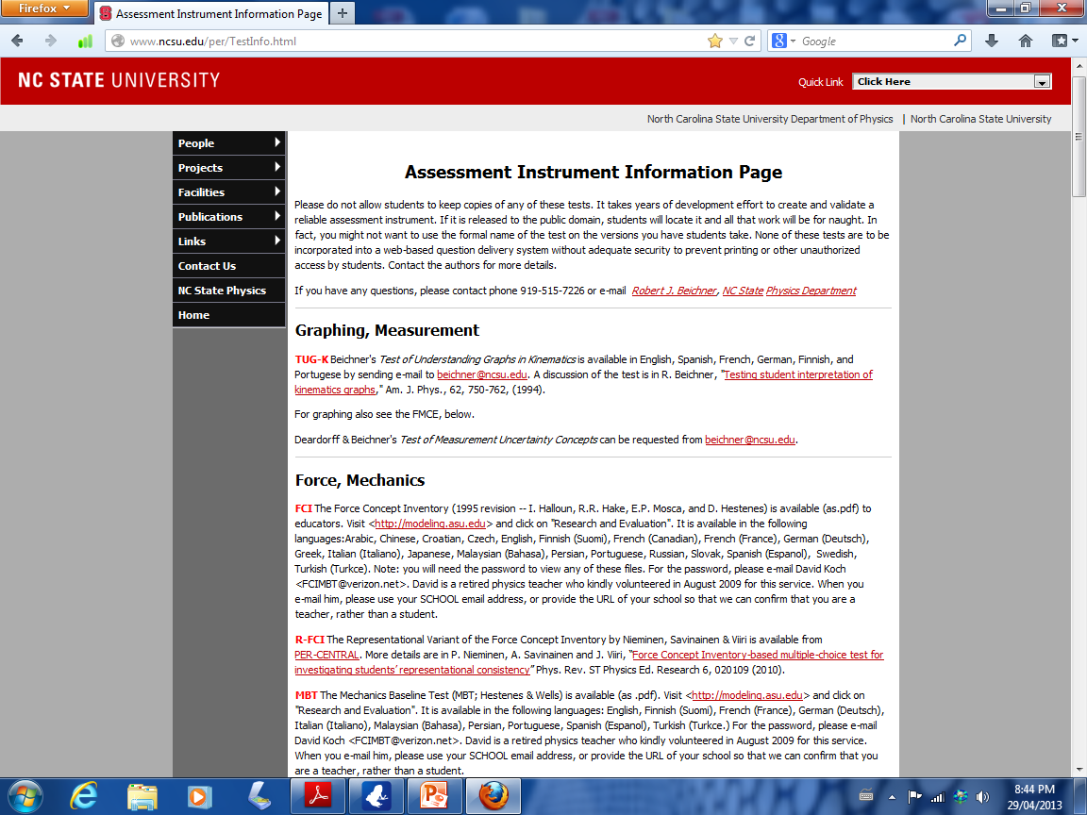

Slide 3
Evaluating Student Understanding
Why Bother…
What do your students know about fundamental physics concepts?
Is your instruction developing understanding of fundamental physics concepts?

Slide 4
Force Concept Inventory (FCI)
Developed in 1992 (Hestenes, Halloun, Swackhammer)
Designed to test understanding for conceptual understanding in Newtonian physics
Tested extensively for validity and reliability
Includes ‘distractors’ to elicit pre-Newtonian thinking (e.g. heavier objects fall faster than lighter objects)

Slide 5
How to Administer a Diagnostic Test
Begin with a pre-test before instruction (this gives a base-line of their initial understanding)
After instruction, give the same test again, post-test (how much learning did they gain in understanding?)

Slide 6
We can extract two quantities…
1) Raw post scores (simply the final mark)
2) % gain in understanding
% gain = (% posttest score) – (% pretest score)
(100 – % pretest score)

Slide 7
Let’s Play!!!
Let’s complete the Force Concept Inventory

Slide 8
Interpreting the Results
Hestenes and Halloun say….
60% is the Newtonian ‘threshold’ where students have barely begun using Newtonian concepts coherently
85% is the Newtonian Mastery threshold where students at this score or above are ‘confirmed Newtonian thinkers’

Slide 9
Interpreting the % gain

Slide 10
Mechanics Baseline Test (MBT)
Designed to test for the most basic concepts in mechanics
Use as a post-test only
Scores are expected to be lower than FCI since it is more difficult
FCI and MBT fit well together and give a broad snapshot of student understanding in Newtonian mechanics

Slide 11
Diagnostic Test for Understanding Graphs in Kinematics (TUGK)
This diagnostic focusses on 3 fundamental areas:
Slope of d-t graph gives velocity
Slope of v-t graph gives acceleration
Area under v-t graph gives displacement

Slide 12
Try This….
Apply FCI as a post test this June to your students (SPH 4U)
Apply FCI as a pre-test this September and post-test in January

